Slide 1
The Kaamvaali Bhai
~Daily House Help Services at doorstep
Rishu Yadav [20BCE0825]
Arnav Srivastava [20BCE0831]
Aditya Kumar [20BCE0833]

Slide 2
Table of Content
Objectives
Introduction
Real Client Details
Client Requirements
Prototype of the Model
Work Breakdown Structure

Slide 3
Project Objectives
01
To provide a smooth and flawless interface for requesting house help services at doorstep with trust and at short notice
02
An application for the welfare of the mostly disregarded people in the society- THE HOUSEHELP
03
A unique platform with several new and one of its kind features such as credit system and trust scores.

Slide 4
Introduction
Our website bridges the gap between a househelp and the families requiring their services . We are transforming India's hiring practises for domestic helpers.
Our goal is to provide trained, seasoned, and pandemic-ready conquerors to our clients.
Under our umbrella, we help and offer a variety of services to choose from for our clients, including both occasional and ongoing services.
This project emphasises on organising the industry, as well as to educate and empower the nearby support staff.

Slide 5
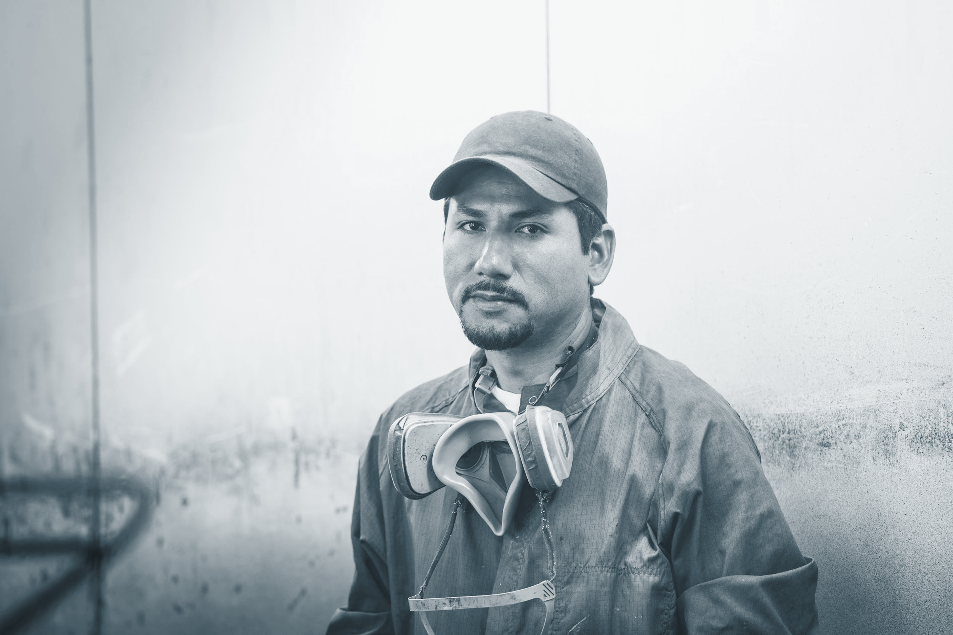


Stakeholders
Customers
Helpers
Cleaners
Sweepers
Chefs
Admin

Slide 6
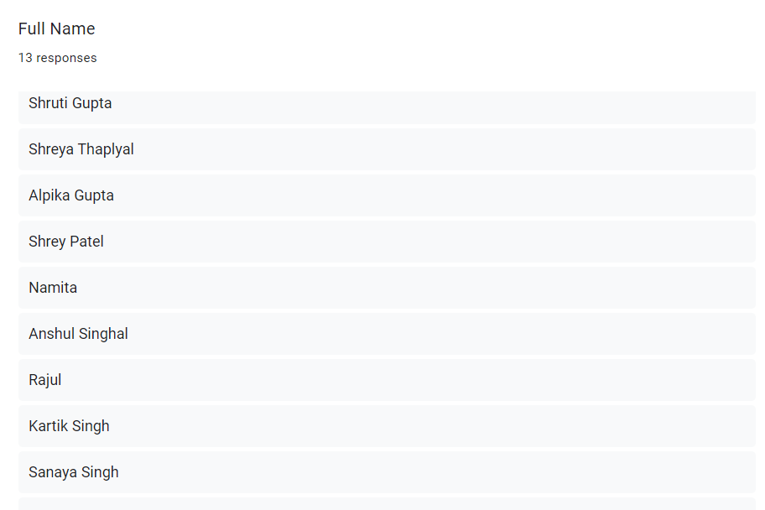
Real Client Details

Slide 7
Client Requirements
According to the survey we did which included 50 people:
73% people were the residents of metropolitan cities
47.4% had family size greater than 8 people
84.2% people had some house helper working at their home
52.6% people agreed that they need house help services on urgent basis sometimes and 42.1% needed it very often
94.7% people find it hard to find a trustworthy maid
People were read to pay for extra services like Dish Washing, Fan Cleaning, Patient Care etc
89.5% people wanted a website which could automate all the house help services on demand for them

Slide 8
Summarizing the Client Requirements
Majority of metropolitan city residents need house help services.
People often find it hard to get a trustworthy house helper.
Many people are ready to pay extra for occasional urgent tasks
Credit System for:
-Fan Cleaning
-Window Cleaning
-Dusting
-Patient Care
-Elderly Care
-Babysitting
People are interested in a centralized website which would help them request and track their services.

Slide 9
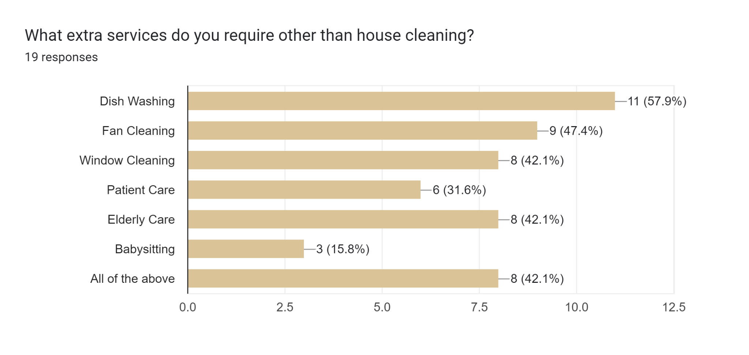
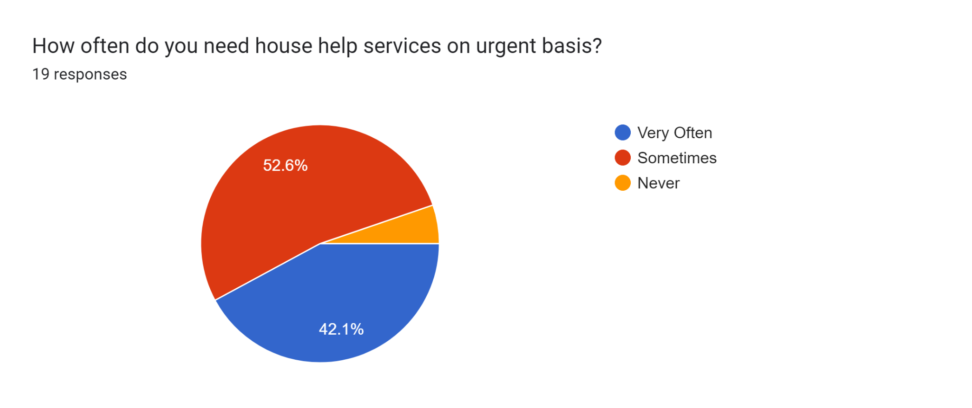
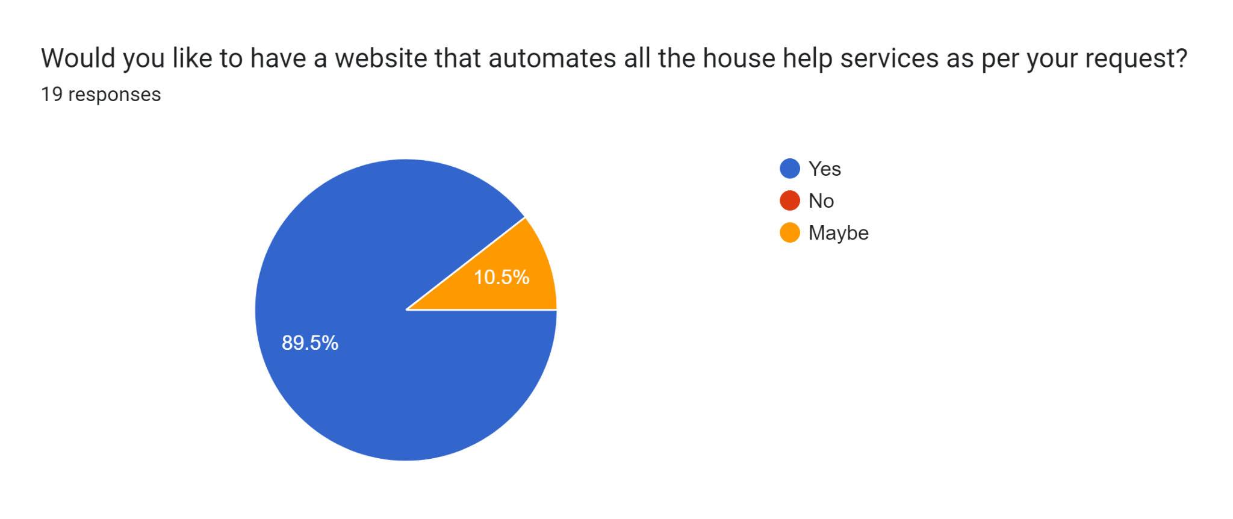

Slide 10
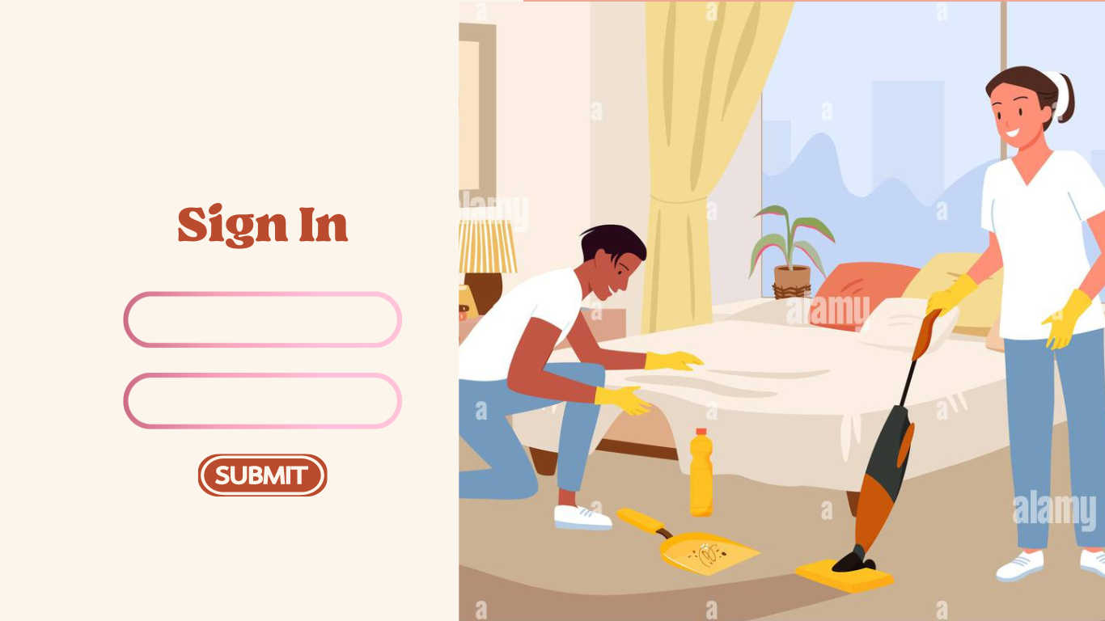
Prototype: Login Page

Slide 11
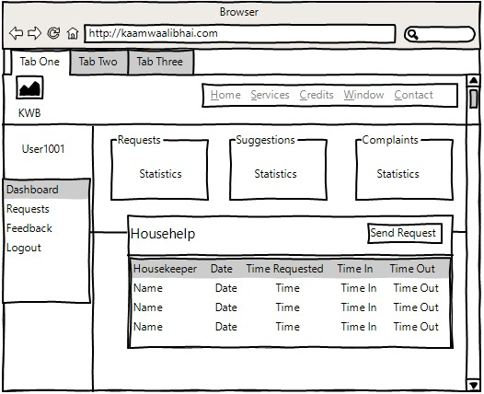
Prototype: Home Page

Slide 12
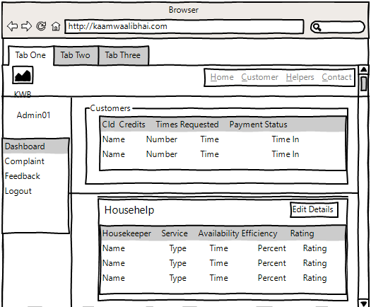
Prototype: Admin Page

Slide 13
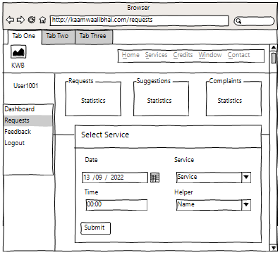
Prototype: Services Page

Slide 14
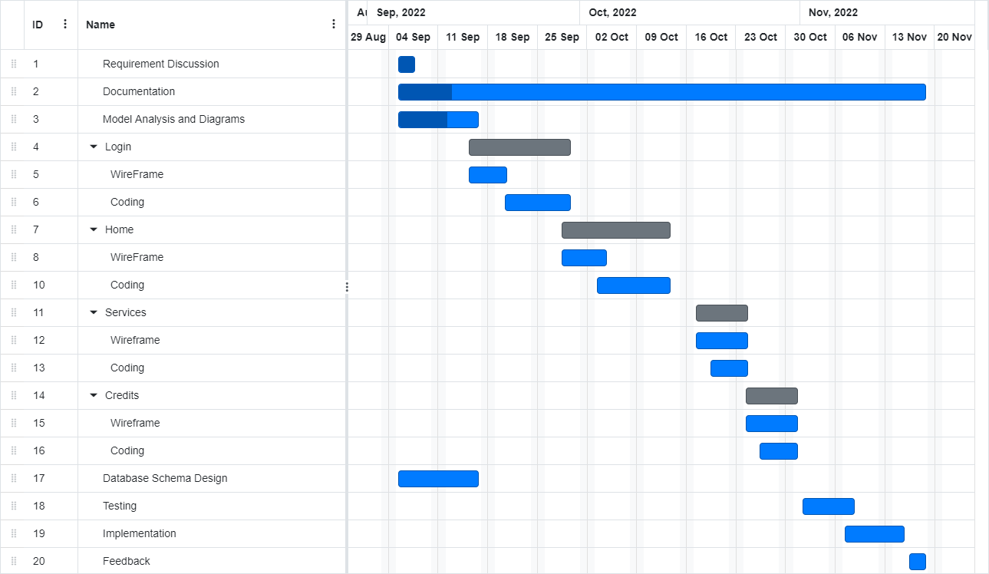
Project timeline

Slide 15
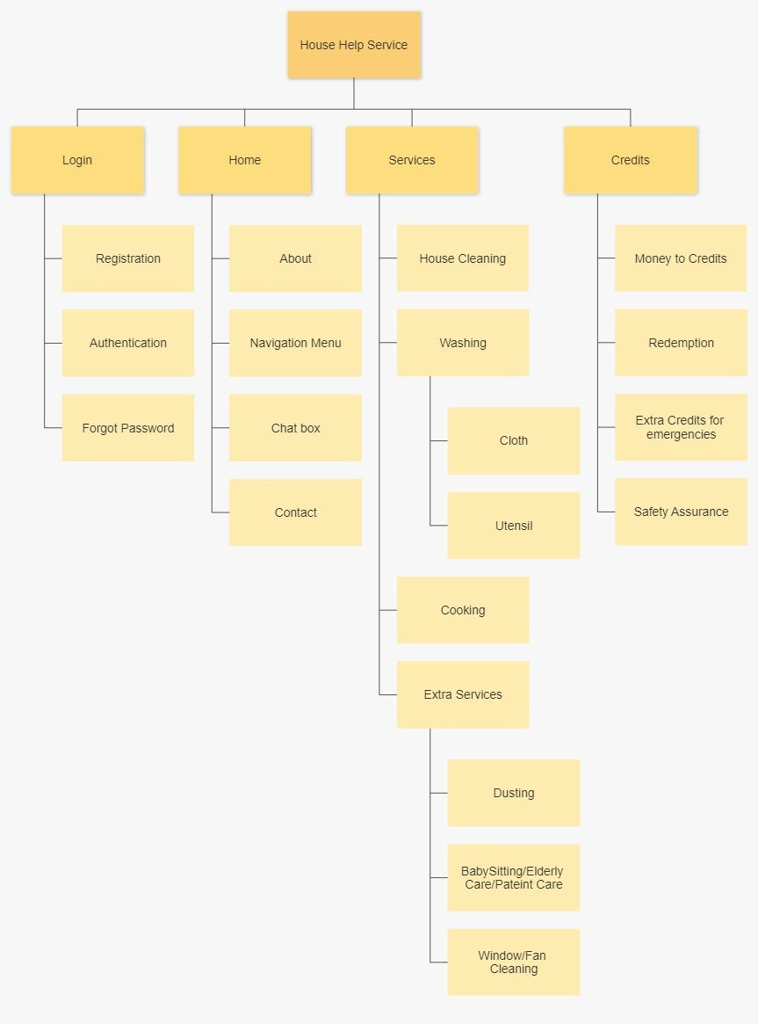
Work BreakDown Structure

Slide 16
Thank You

